Slide 1

Advanced NLP (Word Vector – Bag 1)
NLP
Dr. Sajarwo Anggai, S.ST., M.T. NIDN : 0421108703

Slide 2
NLP Pipeline
Text Preprocessing
Feature Extraction
Modeling
Post-Processing
Deployment
Segmentation/ Tokenization
Normalization/ Lowercasing
Stopword Removal
Punctuation Removal
Stemming/ Lemmatization
Depedency parsing
Part-of-Speech Tagging
Bag of Words (BoW)
TF-IDF
Word Embeddings
Machine Learning
Deep Learning
Prediction
Evaluation
Fine-Tuning
Production
Monitoring and Updating

Slide 3
Word Vector
Word vectors are a type of word representation that captures the semantic meaning of words. They are numerical representations of words in a high-dimensional space, where each word is represented by a vector. These vectors enable computers to understand relationships between words and to perform various natural language processing tasks.
Each word is represented by a real-valued vector, often tens or hundreds of dimensions. This is contrasted to the thousands or millions of dimensions required for sparse word representations, such as a one-hot encoding.
https://www.kubiya.ai/resource-post/what-are-word-vectors

Slide 4
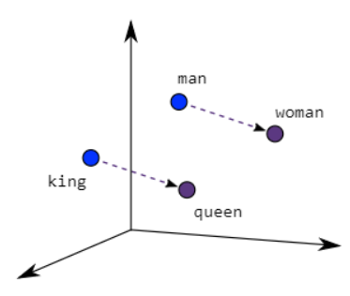
Word2Vec
Word2Vec creates vectors of the words that are distributed numerical representations of word features – these word features could comprise of words that represent the context of the individual words present in our vocabulary. Word embeddings eventually help in establishing the association of a word with another similar meaning word through the created vectors.
https://www.analyticsvidhya.com/blog/2021/07/word2vec-for-word-embeddings-a-beginners-guide/

Slide 5
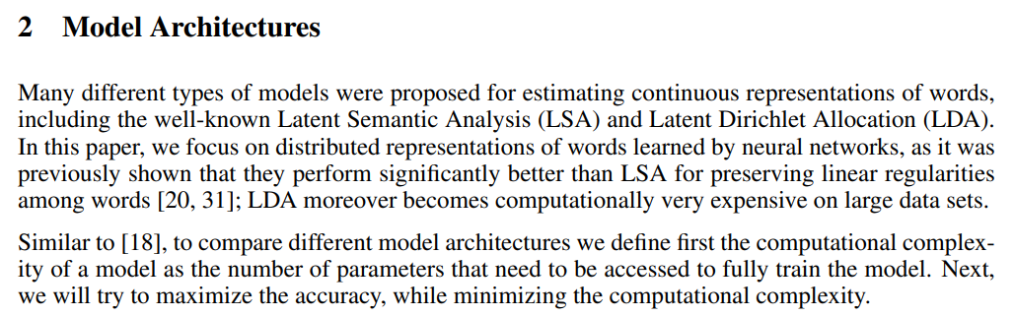
Efficient Estimation of Word Representations in Vector Space
Mikolov, T., Chen, K., Corrado, G.S., & Dean, J. (2013). Efficient Estimation of Word Representations in Vector Space. International Conference on Learning Representations.

Slide 6
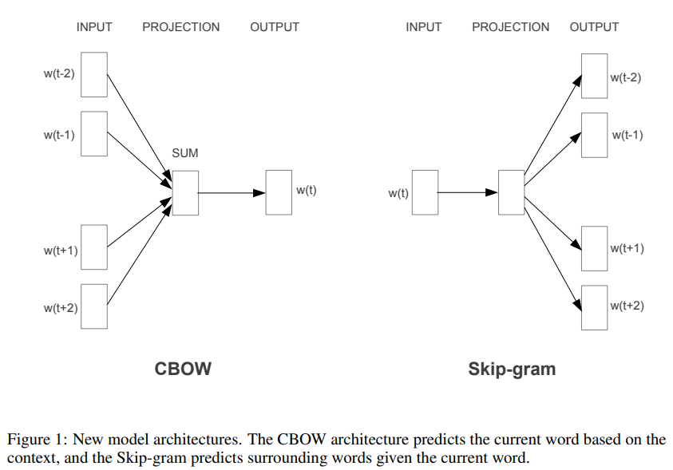
Efficient Estimation of Word Representations in Vector Space
The first proposed architecture is similar to the feedforward NNLM, where the non-linear hidden layer is removed and the projection layer is shared for all words (not just the projection matrix); thus, all words get projected into the same position (their vectors are averaged). We call this architecture a bag-of-words model as the order of words in the history does not influence the projection. Furthermore, we also use words from the future; we have obtained the best performance on the task introduced in the next section by building a log-linear classifier with four future and four history words at the input, where the training criterion is to correctly classify the current (middle) word.
The second architecture is similar to CBOW, but instead of predicting the current word based on the context, it tries to maximize classification of a word based on another word in the same sentence. More precisely, we use each current word as an input to a log-linear classifier with continuous projection layer, and predict words within a certain range before and after the current word. We found that increasing the range improves quality of the resulting word vectors, but it also increases the computational complexity. Since the more distant words are usually less related to the current word than those close to it, we give less weight to the distant words by sampling less from those words in our training examples.
Mikolov, T., Chen, K., Corrado, G.S., & Dean, J. (2013). Efficient Estimation of Word Representations in Vector Space. International Conference on Learning Representations.

Slide 7
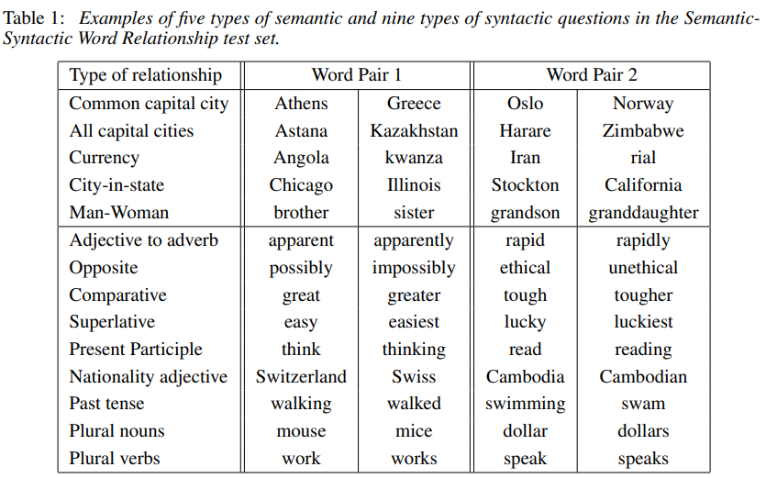
Efficient Estimation of Word Representations in Vector Space
Mikolov, T., Chen, K., Corrado, G.S., & Dean, J. (2013). Efficient Estimation of Word Representations in Vector Space. International Conference on Learning Representations.

Slide 8
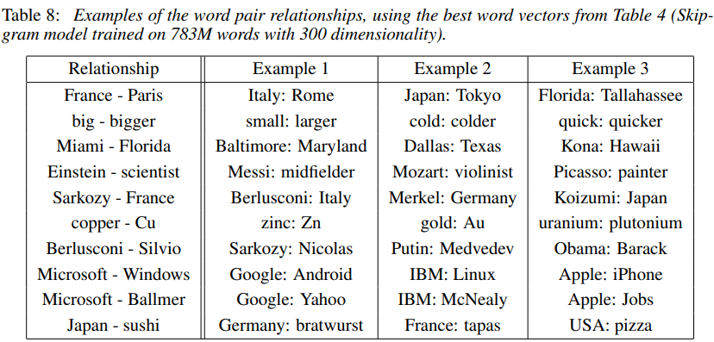
Efficient Estimation of Word Representations in Vector Space
Mikolov, T., Chen, K., Corrado, G.S., & Dean, J. (2013). Efficient Estimation of Word Representations in Vector Space. International Conference on Learning Representations.

Slide 9
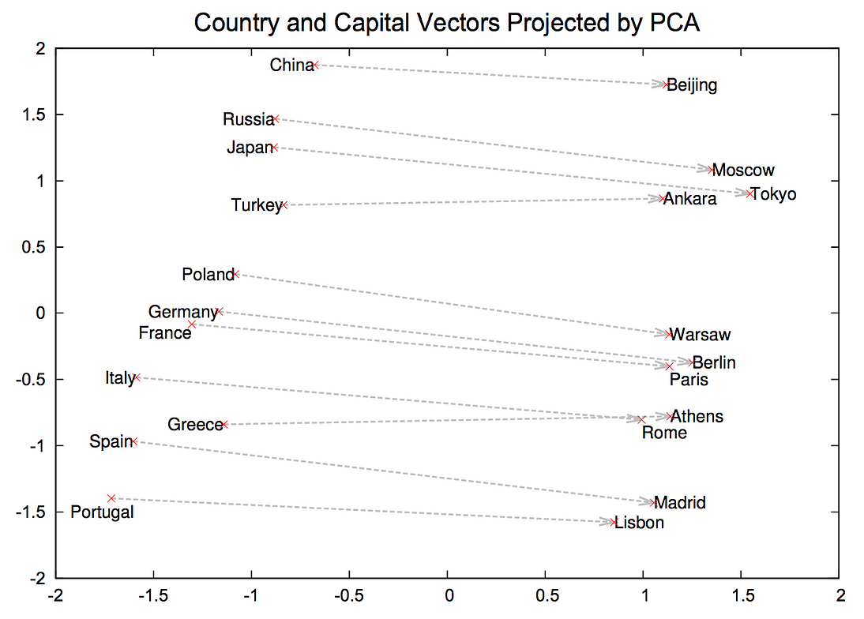
Country and Capital Vectors
https://medium.com/@afrizalfir/mengenal-word2vec-af4758da6b5d

Slide 10
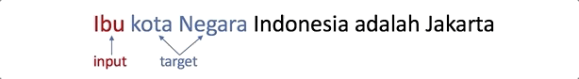
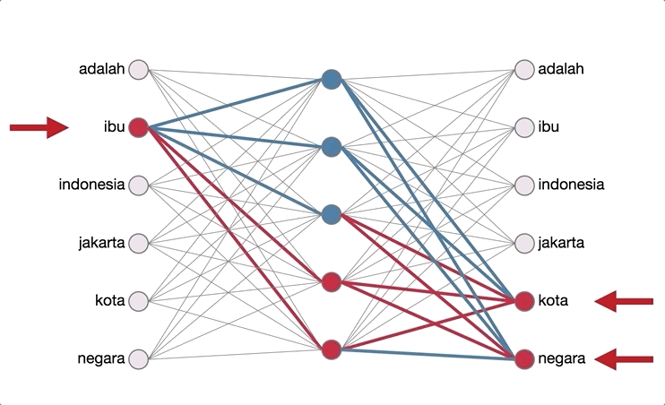
Ilustrasi Skip-Gram
https://medium.com/@afrizalfir/mengenal-word2vec-af4758da6b5d

Slide 11
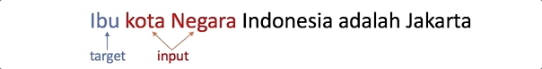
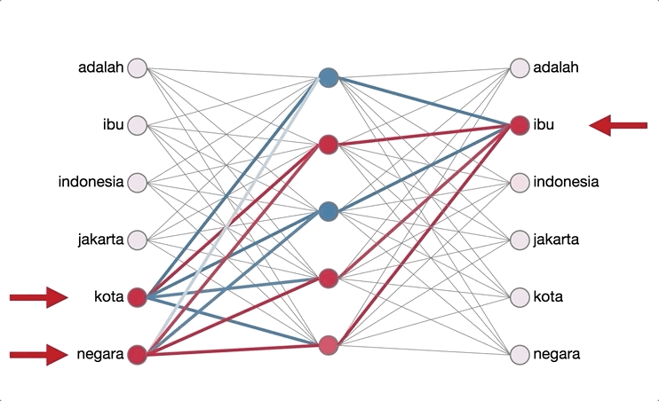
Ilustrasi Continous Bag of Word (CBOW)
https://medium.com/@afrizalfir/mengenal-word2vec-af4758da6b5d

Slide 12
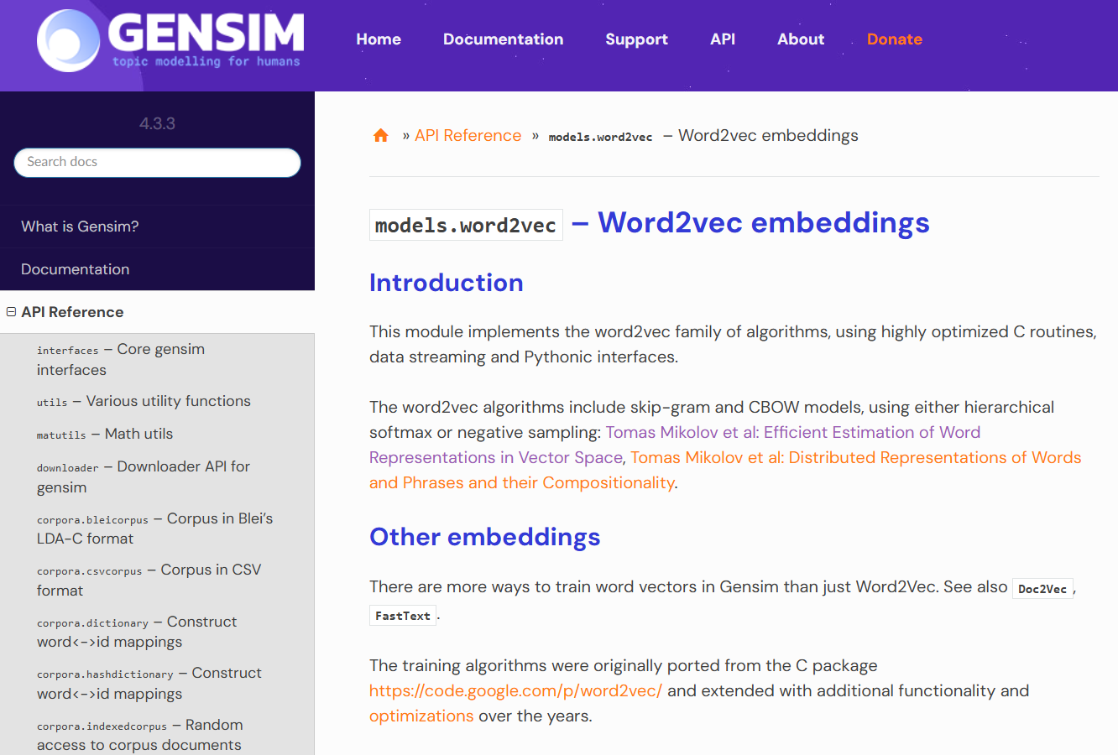
Gensim Library for Word2vec
https://radimrehurek.com/gensim/models/word2vec.html

Slide 13
1. Import Library dan data yang akan digunakan
from nltk.tokenize import sent_tokenize, word_tokenize
import gensim
from gensim.models import Word2Vec
bahasa = [
"Pemrograman komputer adalah keterampilan yang penting.",
"Data digunakan untuk analisis dalam berbagai bidang.",
"Kecerdasan buatan membantu mengembangkan teknologi baru.",
"Pembelajaran mesin adalah bagian dari kecerdasan buatan.",
"Jaringan internet menghubungkan perangkat di seluruh dunia.",
"Perangkat keras dan perangkat lunak adalah komponen komputer.",
"Sistem informasi mengelola data dan pengetahuan.",
]
# Tokenisasi data
tokenized_data = [list(tokenize(text)) for text in bahasa]

Slide 14
2. Membuat Model Word2Vec
wordvec = Word2Vec(
sentences=tokenized_data, #Input data yang sudah di-tokenize
vector_size=100, #Dimensi dari word embeddings, 50-300
window=5, # Jarak maksimum konteks kata dari kata target
min_count=1, # Minimum jumlah kemunculan kata
workers=4 # Jumlah thread yang digunakan untuk training
sg=0, # 0 untuk CBOW, 1 untuk Skip-gram
epochs=10 # Jumlah iterasi training
)

Slide 15
2. Membuat Model Word2Vec
Penjelasan Parameter :
sentences: Data input untuk melatih model, berupa list of tokenized sentences.
vector_size: Ukuran atau dimensi dari embedding vektor. Misalnya, jika vector_size=100, setiap kata akan direpresentasikan oleh vektor berdimensi 100.
window: Jumlah kata di sebelah kiri dan kanan kata target yang akan dilihat sebagai konteksnya. Misalnya, jika window=5, maka kata target akan dilihat bersama 5 kata di sekitarnya.
min_count: Minimum jumlah kemunculan kata agar dimasukkan ke dalam vocabulary. Kata yang muncul lebih sedikit dari ini akan diabaikan.
workers: Jumlah thread untuk mempercepat pelatihan.
sg: Menentukan algoritma yang digunakan. sg=0 untuk Continuous Bag of Words (CBOW) dan sg=1 untuk Skip-gram.
epochs: Jumlah iterasi pelatihan pada data.

Slide 16
3. Melihat Hasil Word2Vec
Hasil Vocabulary
words_in_vocab = list(wordvec.wv.index_to_key)
print("Kata-kata dalam vocabulary:", words_in_vocab[:10])
Mengambil Embedding dari Kata Tertentu
word_vector = wordvec.wv['Word2Vec’]
print("Vektor dari kata 'Word2Vec':\n", word_vector)
Menemukan Kata yang Mirip dengan Kata Tertentu
similar_words = wordvec.wv.most_similar('Word2Vec', topn=5) print("Kata-kata yang mirip dengan 'Word2Vec’:”, similar_words)
Menyimpan dan Memuat Model
wordvec.save("word2vec.model")
loaded_model = Word2Vec.load("word2vec.model")

Slide 17
Ref Tambahan
https://www.geeksforgeeks.org/word-embeddings-in-nlp/
https://www.oncrawl.com/technical-seo/word-vectors-structured-markup-supercharges/
https://parthdevai.medium.com/understanding-word-vector-representation-in-python-a-beginners-guide-803d81722639
https://dzone.com/articles/introduction-to-word-vectors
https://en.wikipedia.org/wiki/Word2vec
https://www.turing.com/kb/guide-on-word-embeddings-in-nlp
https://www.youtube.com/watch?v=ERibwqs9p38

Slide 18
Tugas
Cari 10 jurnal terkait dengan Word Vector Representation
Buatlah interface untuk menampilkan hasil dari Word Vector Representations

Slide 19

Universitas Pamulang
Prodi Teknik Informatika S-2
Sajarwo Anggai
Dosen – Universitas Pamulang
NIDN : 0421108703
Email : dosen02832@unpam.ac.id
Terima Kasih

